Slide 1
PROJECT – 1
By
Bhuban Chakroborty
UNID: UMIP23440

Slide 2

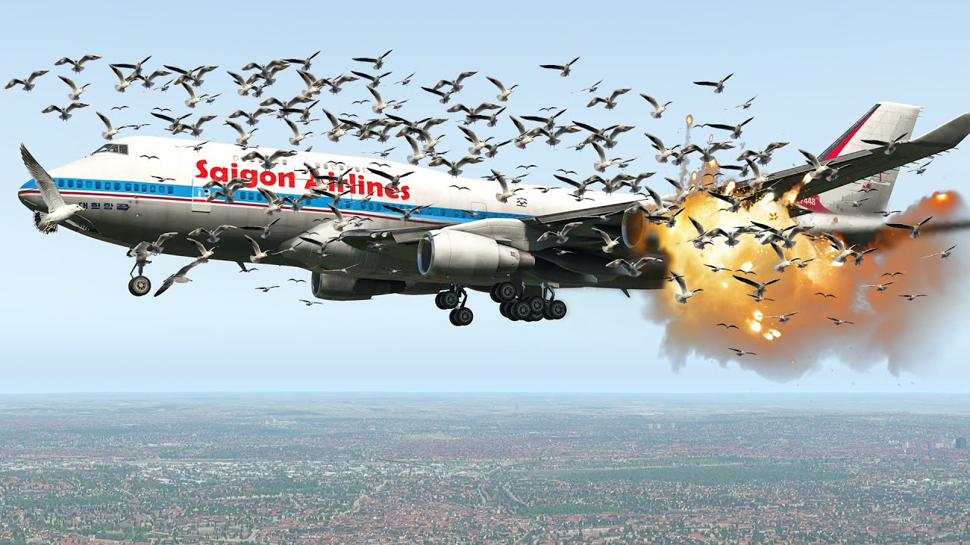
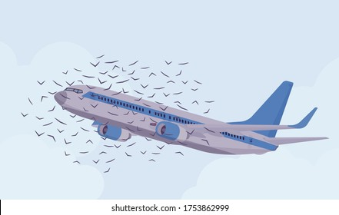
Aviation Bird Strike Analysis

Slide 3
Introduction
I made this Data Visualization of Bird Strikes in Power BI with the Excel Workbook provided by the Unified Mentor team.
A Bird strike is strictly defined as a collision between a bird and an aircraft in
flight or on a take-off or landing roll. The term is often expanded to cover other wildlife
strikes - with bats or ground animals. Bird Strike is common and can be a significant
threat to aircraft safety. For smaller aircraft, considerable damage may be caused to the
aircraft structure. All aircraft, especially jet-engine ones, are vulnerable to the loss
of thrust which can follow the ingestion of birds into engine air intakes. This has
resulted in several fatal accidents.
Bird Strikes can be a significant threat to aircraft safety. Bird strikes may occur during any phase of flight, but are most likely during the take-off, initial climb, approach and landing phases due to the greater numbers of birds in flight at lower levels. To have a closer look the following document visually depicts the data collected on Bird Strikes by FAA between 2000-2011.

Slide 4
Data Insight
The following are the results obtained after the analysis:
Number of Bird Strikes in a Year with a Count of Strikes- It is observed that between 2008 and 2010, the maximum number of bird strikes was reported (5.4K to 7.7K) and the least in 2004 with 4.3k.
Top 10 Airlines with Most Encountered Bird Strikes- XOJET Airlines reported the most number of bird strikes in the tenure and poses a major threat to smooth operations. WORLDWIDE JET CHARTER reported the least count of bird strikes in the tenure.
Top 50 Airports with the most Bird strikes- Orlando Sanford International Airport witnessed 42 bird strikes between 2008-2011, all occurring at altitudes above 1000 ft. with no indicated major damage. Richmond International Airport experienced only one bird strike at an altitude below 1000ft, the lowest among all airports.
Cost incurred due to Bird Strikes- A maximum total cost of $23.3 million was incurred in 2001, with the most damage suffered of $18.6 million due to the Wildlife – Bald Eagle injuring 3 people onboard in that year. Bald Eagles are large birds with significant populations. They are at risk of colliding with aircraft windshields or being sucked into jet engines. A minimum cost of 0.1 million was suffered by American Kestrel wildlife species.
Phase of Bird Strike- Bird strikes are most likely during the approach, takeoff run, climb, and landing Roll due to the greater numbers of birds in flight at lower levels. • Maximum strikes were observed at an approach position with 35.77%(25k). • Minimum strikes were observed at a descent position of 1.87%(1k).
Pilot warning and effect of the strike- • 46.41% were warned of bird strikes.
• 53.59% were not warned of bird strikes.

Slide 5
Data Insight
The following are the results obtained after the analysis:
Avg Altitude of aeroplanes in different phases at the time of the strike- • Bird strikes are maximum for the approach position due to the greater numbers of birds (10 feet). • Bird strikes above 700 feet altitude are about 5.6 times more common during the eve because of bird migration. • Bird strikes are the least for taxied or parked positions.
Effect of strike at different altitudes- • A total of 57k bird strikes occurred, resulting in no damage. Among these, 51k strikes happened above 1000 ft, and 6k occurred below 1000 ft. •Afterwards, a total of 12k bird strikes occurred resulting in damage, with 9k occurring above 1,000 feet altitude and the remaining 3,000 units below 1,000 feet altitude.
Altitude of aeroplanes at the time of the strike- • Altitude below 1000 ft – significant damage caused by high concentrations of ducks and geese. • At altitudes exceeding 1000 feet, minor damage occurs due to the reduced concentrations.. • At higher altitudes, bird populations are reduced due to the influence of high winds, weather fronts, terrain elevations, cloud conditions, and various environmental factors.
Impact of Bird Strike on Flight- • The majority of bird strikes did not cause any harm or emergencies while cruising or descending. The majority of bird strikes accounted for 56k (81.93%). • Precautionary landings and aborted takeoffs also contribute significantly to the impact of bird strikes with 12.90% together. • Engine shutdown due to bird strikes has the lowest occurrence rate among all the impacts with 2.07%.

Slide 6
Main KPIs
● Visuals Depicting the Number of Bird Strikes
● Yearly Analysis & Bird Strikes in the US
● Top 10 US Airlines in terms of having encountered bird strikes
● Airports with most incidents of bird strikes – Top 50
● Yearly Cost Incurred due to Bird Strikes:
● When do most bird strikes occur
● Altitude of aeroplanes at the time of the strike
● Phase of flight at the time of the strike.
● Average Altitude of the aeroplanes in different phases at the time of the strike
● Impact of Bird Strikes on Flight
● Effect of Strike at Different Altitude
● Were Pilots Informed? & Prior Warning

Slide 7
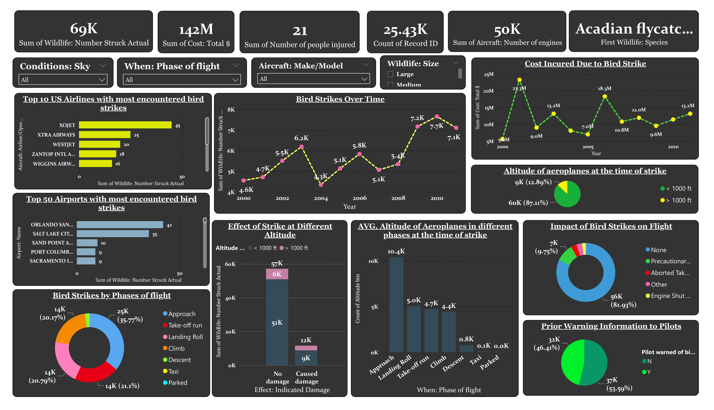
My Dashboard

Slide 8
Conclusion
• Significant damages are caused for smaller aircraft, impacting majorly for engine air intake structures.
• Bird strikes are most likely during the take-off, initial climb, approach, and landing phases due to the greater numbers of birds in flight at lower levels.
• A maximum cost of $23.3 Million was suffered with Wildlife – Bald Eagle (large size and tendency to fly in flocks exacerbate their impact) and a minimum price of 0.1 Million was suffered with Redhead wildlife species

Slide 9
Thank you
Source Excel workbook doc- https://docs.google.com/spreadsheets/d/1PF1PQ4-qg4ySrtyOXiF6SFGX7P0Qfl_r/edit?gid=1443108996#gid=1443108996

